Slide 1
21st Century Teaching, Learning, and Leading (CTLL) Webinar
DoDEA Area and District Leadership Meeting
December 4, 2013

Slide 2
Welcome
DoDEA Area and District Leadership Meeting
December 4, 2013
Notes:
6:23 Greetings to the group
Someone introduces Mr. Adrian Talley, DoDEA Acting Director
Mr. Talley will speak to the superintendents and principals for about 5 minutes.

Slide 3
DoDEA Acting Director
DoDEA Vision and Mission
Education Transformation
“…high-quality instruction requires educators to develop and continuously hone a repertoire of highly sophisticated skills. We live in an increasingly complex and dynamic world where knowledge requirements for student success in college and careers are continually evolving.”
Notes:
6:25:
Adrian’s bullet points:
World changing/schooling is changing (traditional building or new building) to prepare students for future we cannot define.
To meet the change :
21st CTLL is tied to DoDEA Vision and Mission tie to 21st CTLL (focus on high performing schools –engage, educate, empower students in preparation for college and career
21st CTLL is tied to our PreK-12 Education Transformation (professional learning) priorities through the development of Professional Development
21st CTLL is tied to the CSP-develop talent excellence which impacts our school excellence and student excellence
“The 21st CTLL framework recognizes that delivering high-quality instruction requires educators to develop and continuously hone a repertoire of highly sophisticated skills. We live in an increasingly complex and dynamic world where knowledge requirements for student success in college and careers are continually evolving.”
Expectation for all educators to embrace learning.
Not since The Study of Teaching has DoDEA had a focused professional development
DoDEA presents 21st CTLL and the Professional Learning Framework:
6:30 Mr. Talley introduce Melanie Henson and group who will lead the overview of 21st CTLL

Slide 4
21st Century Teaching, Learning, and Leading
Dr. Melanie Henson, 21st CTLL, Headquarters
Notes:
Melanie: Greetings and Welcome, Everyone, to an overview of 21st Century Teaching Learning and Leading.
Our purpose today is to begin the preparation of the 21st CTLL preliminary Phase I implementation. Phase I will begin in the spring of 2014 while the actual implementation occuring in the spring of 2015.
Let me introduce my colleague who are with us today.: Dr. Fran Austin, Acting Deputy Director, CIA of DDESS; Dr. Terry Greene, Deputy Director , CIA of Europe, and Dr. Joyce Lutrey, Deputy Director, CIA of Pacific.

Slide 5
Outcomes:
Understand the DoDEA 21st Century Professional Learning Framework
Focus on the Professional Learning Framework and the professional development opportunities that transform instructional strategies
Articulate and implement the collaborative 21st CTLL structures: Integrated Approach
Digital Professional Learning
Staff Development Coach
Professional Learning Communities
Understand the role of the principal in leading a school to develop the seven 21st Century skills
21st Century School Principal and four roles: Visionary, Organizational, Instructional and Collaborative Leadership
Self-assessment and expectations
Make connections to CSP, MAPA, AdvancED and CCSS
Notes:
Melanie: slides 5-12, 10 minutes
Go over the Outcomes.
This section of the webinar will take you through each component of the Professional Learning Framework, the integrated approach to 21st CTLL, the 21st Century Principal Leadership, the connections and our timeline.
It is our goal that you will be able to use this power point, its content, and the 21st CTLL website to build your capacity and the capacity to build others.

Slide 6
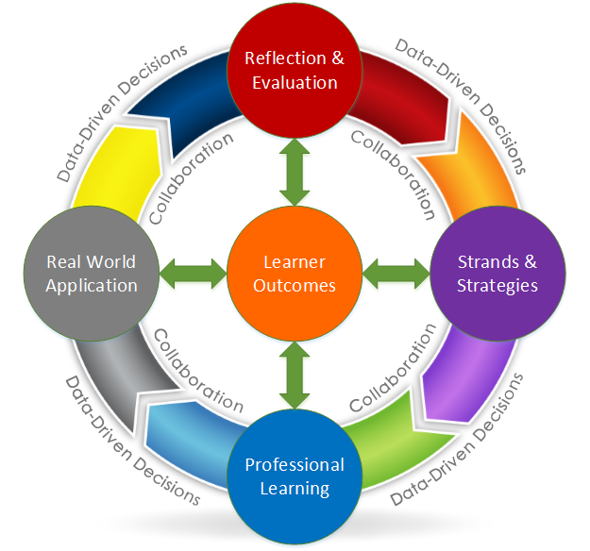
Professional Learning Framework
Notes:
Melanie: 20 minutes slides 5-11
This graphic represents the Professional Learning Framework cycle. The Professional Learning Framework (PLF) provides a continuous, customized professional learning cycle that evolves to support and meet the needs of our educators over the next several years. The cycle is universal and applies to all learners and to all types of content.
We begin the cycle with the Learner Outcomes, the heart of the cycle. The cycle moves from Learner Outcomes to Reflection and Evaluation to Strands and Strategies, to Professional Learning to Real World Application and back to Reflection and Evaluation. You will notice that collaboration and data-driven decision making are continues throughout the learning cycle.

Slide 7
21st Century Learner Outcomes
Standards
Based
Notes:
Learner Outcomes: The learning cycle begins in the center and focuses on the outcomes of the learner. Content knowledge and the 21st century skills (the Seven Survival Skills of Tony Wagner) combine to create the learner outcomes. The learner outcomes provide what is to be learned and demonstrated. DoDEA has adopted the Wager Survival Skills.
This graphic shows how the 21st century skills and the content standards work together. The 21st century skills are taught through the standards. Whether we use our DoDEA Standards or the Common Core State Standards, content and skills together create the 21st Century Learner Outcomes.

Slide 8
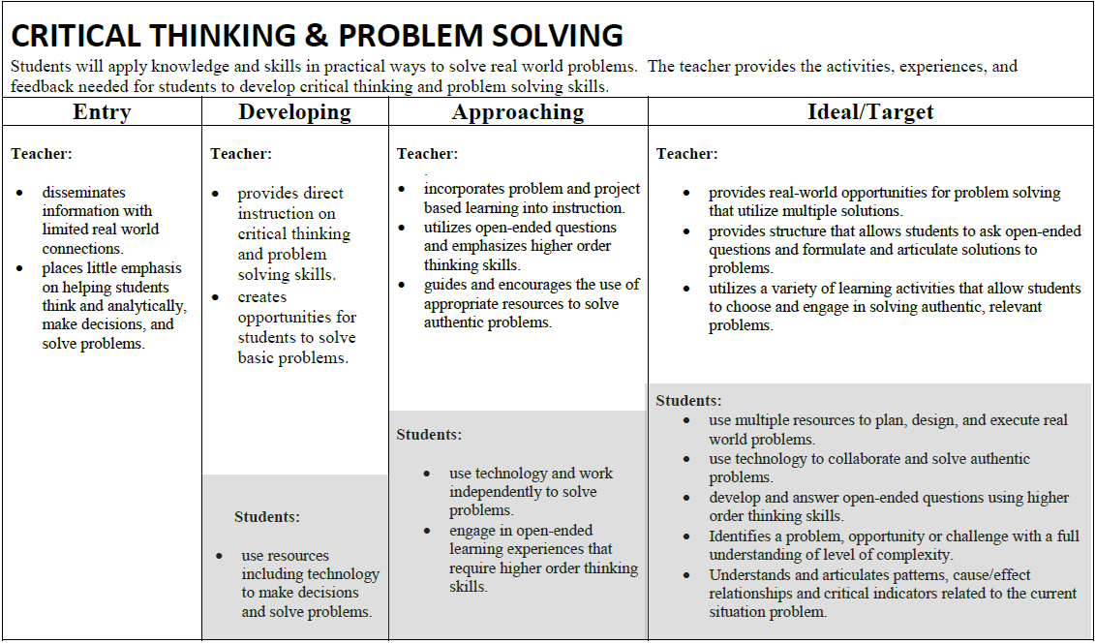
Reflection
Notes:
Reflection: Once the learner outcomes and the 21st century skills are established, they move to the Reflection and Evaluation section of the learning cycle. The learner(s) reflect on what they know by using the Reflection rubrics (teachers and students) or self-assessment tools (leaders).
The Reflection and Evaluation Rubrics:
There are seven rubrics that align with the seven 21st century skills.
The seven Reflection and Evaluation rubrics are designed for teachers and their students to use at the beginning of a lesson design and again at the end of the lesson cycle to evaluate the progress of learners after applying the 21st century skills to their work. Each rubric supports the growth of a student-centered classroom where students become more engaged in the learning process and can apply the Learner Outcomes (knowledge and skills) to the real world. The reflection section drives the educators decision for instructional practice professional learning and selection.
Walk through this so participants understand this well. The goal is to move from the entry level of development of the skills to the ideal/target level for both teachers and students.

Slide 9
Strands and Strategies
Notes:
Strands and Strategies: Once educators/teachers reflect on their level of readiness of the 21st century skills, they determines what pedagogical area in the toolbox will enrich their teaching and learning practice.
Currently, there are six strands or categories of learning. Each strand has a minimum of three strategies that support the building of pedagogical knowledge in each strand. The strands, LE, SCI, CI, TI, MCC, and SL (read from the screen), provide descriptors/attributes of what successful 21st century schools do.
Educators will select from the toolbox (Digital Professional Learning) the strands and strategy(ies) that best support their learning. Once a teacher selects the best learning opportunity, the teachers are ready to begin learning and collaborating together.

Slide 10
Professional Learning
Notes:
Professional Learning: The engagement in learning occurs during the professional learning or collaborative timeframe. The learner or a group of learners delve into the choice of their learning. The group works together using the professional learning guide that promotes inquiry, application, and data results of the learning.
Professional Learning Communities provide educators time during the school day for job-embedded professional learning and the ability to focus on practice and student learning. Teachers no longer have to solve problems alone but work together to change how they solve the problems of practice. The learn, intentionally plan, and prepare for learning in stronger ways as a team.

Slide 11
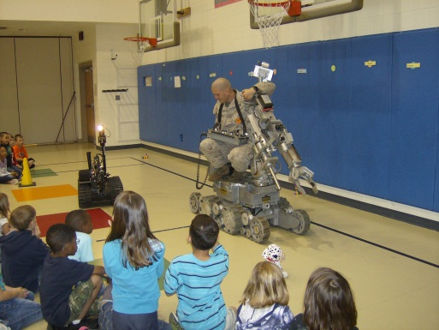
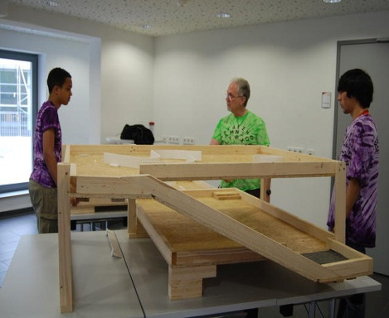
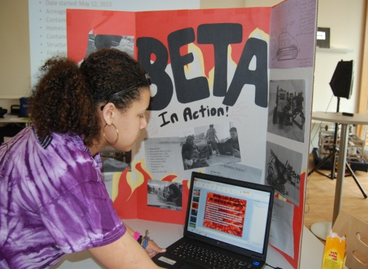
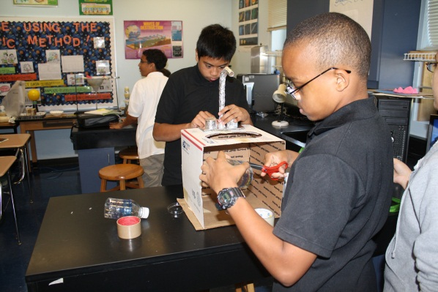
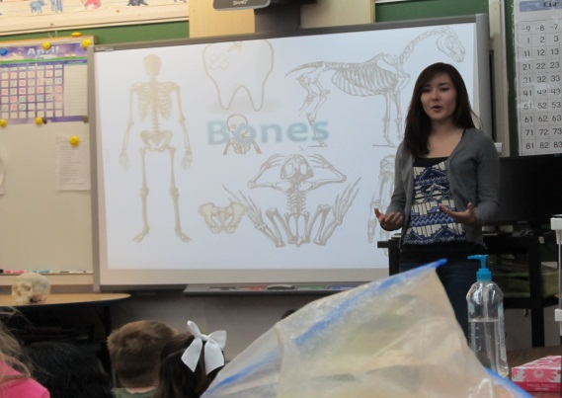
Real World Application
Notes:
Real World Application: Simultaneous with the collaboration phase, the learner(s) apply their new skill sets appropriately. Leaders apply the learning to the context of the school and/or the community. Teachers apply the learning to their work with students in the classroom and/or an aspect of the school. Students apply their classroom knowledge to their personal lives, school, community, and/or global aspects learning. Evidence of learning is gathered to determine how successful the application of the learning has been.
Students are expected to be actively engaged in critical thinking, solving problems, to create new solutions by communicating and collaborating together.
STEM has provided us the entry into application of knowledge to solve real world problems for today and for the future. Project based and problem based learning are excellent student centered instructional strategies that support the shift to 21st CTLL and real world application through the 21st century skills. The focus on student centered learning shifts the expectation to student engagement and student empowerment to apply learning in new and relevant ways.

Slide 18
Notes:
The cycle concludes with a reflection on the learning and its evidence of success. A new learning cycle grows from the data to place the learner(s) on a continuous learning path. The continuous learning cycle’s intent is to deepen knowledge and broaden its application to multiple aspects of life and work for all learners.
Our goal is that you are able to articulate the PLF and how this supports professional learning for all educators. As you visualize how 21st CTLL will develop in your Area/District and Schools, your ability to include others and build their capacity will make the difference.
Conclude: Introduce Joyce Lutrey

Slide 19
Integrated Approach to Professional Learning
Dr. Joyce Lutrey, Deputy Director, CIA Pacific
Notes:
Joyce Lutrey: slides 13-14, 10 minutes

Slide 20
An Integrated Approach to Professional Learning
Digital Professional Learning
Staff Development Coach
Professional Learning Communities
Notes:
21st CTLL has been designed as an integrated approach, a set of structures if you will, to support teaching, learning, and leading. These three structures are imperative to have in place for job-embedded professional learning to occur.
The Digital Professional Learning provides educators the strands and strategies toolbox of learning options available 24/7. From the Digital Professional Learning toolbox educators will select the professional learning based on their reflection of their needs. Once selected, teachers work in their collaborative settings to learn and apply new skills to practice.
The Staff Development Coach is a new position that will support their school’s teacher professional learning, guide learning to practice, and are the teachers’ advocate. This position is solely based on teacher learning and their support and focus on student centered classrooms.
Professional Learning Communities will be a system–wide professional practice that provides teachers time the time to collaborate, focus on teaching and learning, and become analyze student data to determine if new practices result in greater student learning . In the fall of 2014, DoDEA will provide a systems launch.
Conclude: introduce Fran Austin

Slide 21
Principal Leadership Roles and Connections
Dr. Fran Austin, Acting Deputy Director, CIA DDESS
Notes:
Fran: slides 15-20, 15 minutes

Slide 22
21st Century Principal Roles
https://content.dodea.edu/VS/21st_century/web/21/index.html
Notes:
The 21st CTLL Leadership Group’s charge was to determine what a 21st Century principal was and to determine the critical roles of the 21st Century principal and how they are different from the 20th Century principal.
The 21st Century principal and four critical roles are defined.
The DODEA 21st Century School Leader is One Who Educates, Empowers, Engages and Excels through visionary leadership that inspires ALL to be intentional learners, to think critically and to work collaboratively to meet the demands of a global, digital and dynamic world.
The DODEA 21st Century School Leader should effectively demonstrate excellence in the following four roles:
Visionary Leadership - The effective 21st Century DoDEA school leader inspires and leads the development and implementation of a shared vision, goals and plan for comprehensive integration of 21st Century skills to promote high academic standards and support transformation within the school.
Instructional Leadership - The effective 21st Century DoDEA school leader provides direction, coordination, and resources for the improvement of Curriculum, Instruction, and Assessment through teaching, leading, and learning.
Organizational Leadership - The effective 21st Century DoDEA school leader develops and utilizes systems and protocols to creatively and efficiently manage people, data, processes and resources to foster continuous improvement.
Collaborative Leadership - The effective 21st Century DoDEA school leader builds and sustains strong and enduring relationships to engage, educate and empower students, families, command, community, and other stakeholders. The collaborative leadership role has a direct impact on morale, readiness and quality of life for our military partners.
The four roles and their competencies were aligned to MAPA, ISLLC, NET-A.
Based on their research, the Leadership Group recommended that MAPA be revised in the future.

Slide 23
Roles and Competencies
Instructional
Guides, monitors and supervises effective instruction and assessment
Models digital tools
Provides structures for shared and collaborative professional learning that values risk taking
Provides a student-centered learning environment
Visionary
Shares leadership and uses data to develop a plan
Aligns curriculum, instruction and assessment
Inspires communicates a shared and collaborative vision
Supports digital Learning
Creates and supports a risk-taking environment
Notes:
The 21st Century Teaching Learning, and Leading (CTLL) Technical Working Group (TWG) developed a set of tools that provide principals a means to understand the shift from a 20th century principal to a 21st Century School Principal. The Roles and Competencies, including the behavioral indicators, provide school leaders with clear guidance and expectations of the shift from the typical school leadership role.
Above and on the next slide are the identified roles and competencies for a 21st Century Principal.
Elaborate on the importance of the following as essential to a 21st Century Principal that creates and sustains a 21st Century learning environment.
Visionary Leadership
Shared leadership and
Creating and supporting a risk free environment
Instructional Leadership
Provides structures for shared and collaborative professional learning that values risk taking
Provides a student-centered learning environment

Slide 24
Roles and Competencies
Organizational
Maximizes use of resources to include technology and 21st Century Teaching Learning and Leading
Ensures safety and security
Maximizes human resources and support operations and systems
Maximizes the use of space in and outside the school
Creates and uses a data driven plan toward increased student achievement
Collaborative
Effectively engages, educates and empowers the educational community and public by using 21st Century Communication avenues
Builds and sustains strong and enduring relationships and partnerships with all stakeholders
Fosters learning communities for professional collaboration among all stakeholders
Fosters learning communities for professional collaboration
Notes:
Elaborate on the following
Organizational Leadership
21st Century Principals understand how to maximize the use of space, time and resources to create and lead 21st Century School.
They understand how to organize and align the school learning environment with curriculum and instruction to effectively implement 21st CTLL.
Collaborative Leadership
21st Century Principal embraces shared leadership to work collaboratively in establishing a risk-free school-wide learning environment for all. They build and sustain strong relationships with students, teachers, parents, community and military partners. They successfully foster professional collaboration and development among all stakeholders.

Slide 25
Roles and Expectations
Superintendent
Build capacity in 21st CTLL
Principal
Build capacity to implement 21st CTLL
Build capacity for schools to make the Connection between CTLL, CCSS, STEM, MAPA, CSI, CSP
Support the Integrated Approach to CTLL
Participate in the District Network Team meetings
Communicate and collaborate with the community and command
Build capacity to implement the Connections between CTLL, CCSS, STEM, MAPA, CSI, CSP
Build capacity to implement the Integrated Approach to CTLL
Participate to build plans based on the District Network Team meetings professional learning
Communicate and collaborate with staff, students, parents, and community
Notes:
These are the expectations for 21st Century Leaders.

Slide 26
Roles and Competencies
Occupational Competencies for School Leadership
Visionary
Instructional
Underlying Competencies
Influencing and Negotiating Team Building Definition
Gain cooperation from others to obtain information and accomplish goals. Anticipate and take steps to build consensus to reach goals. Manage and resolve issues and disagreements in a constructive, student centered manner.
Influencing and Negotiating Team Building Task
-Actively listen and involve staff and teams or work units in resolving differences over work issues (e.g., schedules, assignments, ensuring employee and organizational concerns are balanced.)
-Anticipate the range of reactions that typically occur when change is introduced and builds consensus on processes to achieve the goals.
-Coach, teach, counsel, and motivate employees toward greater mutual respect and understanding.
-Demonstrate skill at reframing an issue so alternate perspectives and opposite views can be understood, and perhaps, accommodated.
-Seek input of staff through their representative associations or union officials to address matters that affect them in the workplace.
-Demonstrate the ability to be alert to means and opportunities to inform the larger organization and other stakeholders of the credibility and value of the group’s work, to solicit support, and gain buy-in.
Specific Knowledge for Underlying Competencies
Organizational
Collaborative
Flexibility
Developing Others
Influencing and Negotiating Team Building
Decisiveness
Problem Solving
Written and Oral Communication
Accountability
Notes:
In order to align and conform to the new DoD and OPM guidance for the development of competencies as they pertain to the broader responsibilities of school administrators, a School Administrator Competencies Workgroup has been established at HQ to continue this work.
They will complete the following tasks:
• Revise the existing leadership competencies developed by the 21st Century TWG leadership group by COB Friday, 20 December 2013.
• Vet/Socialize the revised competencies with district superintendents and area directors.

Slide 27
Connections
PreK-12 Education Transformation
Community Strategic Plan
Continuous School Improvement
AdvancED
Dr. Terry Greene, Deputy Director, CIA Europe
Notes:
Terry: slides 21-25, 15 minutes
All of our programs are connected.

Slide 28
DoDEA’s PreK-12 Education Transformation
Common Core State Standards
Aligned Assessments
21st Century Teaching, Learning, and Leading
Digital Learning Environments
Modern 21st Century Facilities
Science, technology, Engineering, and Mathematics (STEM)
Recruitment and Retention of Highly Qualified Teachers and Administrators
Notes:
Marilee Fitzgerald outlined seven organizational priorities as we embark on the PreK-12 Education Transformation. More may be added as we move forward.
The first priority is the introduction of the Common Core State Standards in the subject areas of mathematics and English language arts for grades K-12.
The second priority includes the adoption of assessments that are aligned to the Common Core State Standards.
The third priority is the 21st Century Professional Learning Framework, which you have familiarized yourself with these past two days.
The fourth priority is the conversion to digital learning environments.
Priority five has to do with the modernization of school facilities to align with 21st century instruction.
The sixth priority is the emphasis on the integration of Science, Technology, Engineering, and Mathematics.
Finally, priority seven leads us to a focus on recruiting and retaining highly qualified educators and principals. As we embark on this journey together, let us keep these priorities in mind.

Slide 29
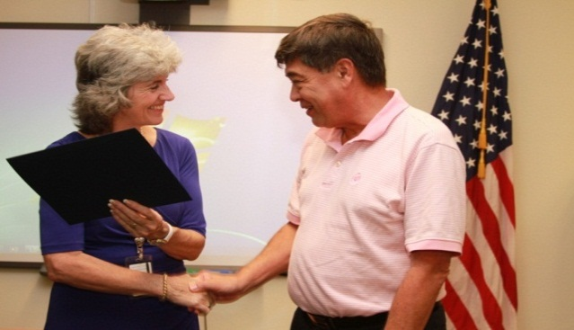
Community Strategic Plan
Goal
5
Outreach Excellence
Goal
4
Organizational Excellence
Goal
3
Talent Excellence
Goal
2
School Excellence
Goal
1
Student Excellence
Notes:
At the beginning of every school year, we ask ourselves two questions as we set our school goals: “How can this help each student reach his or her fullest potential?” and “How does this relate to our Community Strategic Plan?”
Let’s take a moment to review the five goals:
Student Excellence,
School Excellence,
Talent Excellence,
Organizational Excellence, and
Outreach Excellence.
21st CTLL focuses primarily on Goal 3: Talent Excellence. We are focusing on improving the development and empowerment of our employees, which is measure five under Goal 3. We are also focusing on all DoDEA teachers and school administrators demonstrating knowledge and application of 21st Century Teaching, Learning, and Leading (CTLL) strategies, which is measure six under Goal 3. These two measures not only connect to Talent Excellence, but connect to all other goals as well. By allowing educators to select their own professional development to support their own growth, we are helping our schools, students, organization, and military-connected communities succeed. We are building collaboration, shared leadership, and preparing our students for their futures.

Slide 30
CSP and AdvancEd Connections
AdvancED/DoDEA CSP | CSP Goal 1 Student Excellence | CSP Goal 2 School Excellence | CSP Goal 3 Excellence in Talent Management
Standard 3 Teaching & Assessing for Learning | AdvancED Indicator 3.1 - 3.7, 3.10 & 3.11 - Teachers and school leadership ensure student excellence through the implementation of the school's curriculum, the delivery of content through sound instructional design, and the administration and evaluation of the content of the curriculum through the assessment practices. AdvancED Indicator 3.8 - Schools engage families in all parts of the learning process to ensure student excellence. AdvancED Indicator 3.9 & 3.12 - The school has a formal structure and learning support services to ensure students are supported by and have a feeling of belonging that supports the students overall educational experience. | AdvancED Indicator 3.2 - Systematic collaborative process in place to insure align with CIA. AdvancED Indicator 3.4 - Leadership monitor instructional practices through supervision and evaluation. AdvancED Indicator 3.5 - Teachers participate in collaborative learning communities to improve instruction and student learning. AdvancED Indicator 3.7 - Mentoring, coaching, and induction are present to support innovative teaching and learning. AdvancED Indicator 3.8 - Schools engage families in meaningful ways (DoDEA performance measure 2.6). AdvancED Indicator 3.9 - School has at least one adult advocate to support the students' educational experience (Caring relationships) | CSP/DoDEA Goal 3.5 (Leaders facilitate professional growth and development); CSP/DoDEA Goal 3.6 (Teachers and leaders will demonstrate knowledge and application of learning expectations) AdvancED Indicator 3.4 (Instructional strategy plan; leaders plan for improvement of teaching and support of student learning) *CSI/Advanced Ed Standard 3 is all about CSP/DoDEA Goal 3
Notes:
Handout: CSP and AdvancEd Alignment
As leaders the more we prepare ourselves to lead our staff in making connections of the work we do with all of our programs, the stronger the work and the better results we have for our students, our teachers, and our schools.
AdvancEd is a standard our schools must achieve to be certified. The alignment of our AdvancEd Standards to our CSP provides us a clear vision that when we work to meet one standard we are working to meet another standard and the CSP goals. The above provides the AdvancEd standard 3, Teaching and Assessing for Learning. You have a handout that provides the larger alignment of AdvancEd to the CSP.
Read through the AdvancEd standard 3 for Teaching and Learning. Realize that each of the indicators aligns with a CSP goal. When we as leaders purposefully provide our staff the connections of the standards and goals to the work we are doing in our schools, we work towards one goal, EXCELLENCE in all we do.

Slide 31
Organizational Connections
CSP
21st CTLL
CCSS
STEM
AdvancED
Digital Environment
Hiring Reform
Notes:
How we introduce a new concept to our teachers sets the stage for the “one more thing that has to be done or shows how all of our work is aligned and connected.” When we take care in the way we introduce these elements, we can present them in such a way that they are seen as connected and interwoven together for a seamless tapestry of excellence.
The members of the Jumpstart Development are developing “Faculty Quick Chats.” The purpose of the “Faculty Quick Chats” are to help you show your faculties the connections between all of these standards and requirements and the important work they do every day preparing students for success.
Please keep in mind that before you do these Faculty Quick Chats, it is important to review the major DoDEA puzzle standards and segments with your educators so that they see how they align together. Each Faculty Quick Chat presentation will include slides and overviews that you or a teacher leader can share with your faculty before engaging in the hands-on activity. Also, the Quick Chats have been purposefully designed to model 21st century instructional practices that can be used in the classroom.
Joyce will do the timeframe.

Slide 32
CTLL Timeframe
Phases of Implementation
Dr. Joyce Lutrey, Deputy Director, CIA Pacific
Notes:
Joyce: slides 26-28, 5 minutes
All of our programs are connected.

Slide 33
Timeframe
Phase I: Fall 2014 | Fall 2014: Systemwide | Phase II: Fall 2015
Staff Development Coach and 5 day training | Professional Learning Communities (systemic 3 year development) | Staff Development Coach and 5 day training
Jumpstart, 5 day training |  | Jumpstart, 5 day training
Digital Professional Learning |  | Digital Professional Learning
District Network Team Meetings |  | District Network Team Meetings
Notes:
Joyce:
21st CTLL Implementation time frame: Phase I –Fall 2014, PLC System-wide - Fall 2014, Phase II - Fall 2015 with the program work designated for that time frame.
The launch of 21st CTLL has three phases and each phase contains several components to support professional to implementation of practice.
Phase I begins with a small set of 15 schools, all of which opened or are opening between a designated time frame. The key integrated structures for Phase I include:
Receiving a Staff Development Coach whose focus is school based professional learning and support of teaching and learning. The District ISSs will work hand in glove with these SDCs to support teacher practice.
Receiving a 5 day Jumpstart that provides an overview of 21st CTLL, the nuts and bolts of organizing a school move and transition to a 21st century school, and training on one student centered instructional strategy, Project Based Learning.
Receiving the Digital Professional Learning, which is a result of the Strands and Strategies development. Teachers will select their learning from this 24/7 professional learning toolbox. Once selected teachers will work in Professional Learning communities to learn and to apply their skills to their practice.
Receiving District Network Team Meetings for leadership and SDC. These monthly meetings provide time to plan, develop, discuss problems of practice as a District team to implement 21st CTLL.
*All Districts will begin in February with the District Network Team Meetings.
Fall 2014 will bring system-wide professional learning on Professional Learning Communities. All schools will begin in the fall of 2014 and the vendor will support the work for 3 years.
Phase II and III will include 86 DoDEA schools per year. They will receive all key components that Phase I did. Modifications to the program will be made based on feedback from the Phase I schools.

Slide 34
Phase I: 15 Schools
DDESS | EUR | PAC
Barsanti ES – Ft Campbell | Shape ES | Osan ES
Shugart MS – Ft Bragg | Vicenza ES | Humphreys MS/HS
Shugart ES – Ft Bragg | Vicenza MS | Ikego ES
Heroes ES – Camp Lejeune |  | Kinser ES
Irwin IS – Ft Bragg
Hampton ES – Ft Bragg
Murray ES – Ft Stewart
Crossroads ES - Quantico
Notes:
The Phase I schools list is the above list for slated for January 2014.
Conclude and Melanie will close the session.

Slide 35
Thank You!
21st CTLL Vision
https://content.dodea.edu/VS/21st_century/web/21/index.html
Notes:
Melanie: 5 minutes
Thank you for joining us today. I am going to share with you the 21st CTLL website that has all of the information we shared today.
Have the 21st CTLL website open for quick access:
In the 21st CTLL website, you will find all of the information we have shared today.
Show the website and point out the Principal section and the Professional learning section. Use this website to build your capacity and build your vision of 21st CTLL. It is up to you to build
A risk free collaborative learning environment
Develop a student centered approach to teaching, learning and leading,
Promote curriculum and technology integration
Support and advocate for the military child
Develop shared leadership to create the transformation to 21st CTLL
All educators will have the opportunity to have job-embedded collaborative professional Learning.
It is up to you to create with your staff and to lead the 21st CTLL vision for your Schools.
Credits-and debriefing

Slide 36
Credits
21st CTLL Team
Jumpstart Development Team
DDESS, EUR, and PAC for photos and video clips
Area Deputy Directors, CIAs
Area and District Office Support Staff
Headquarters Staff
Notes:
We want to thank the above listed groups and educators for their tireless support, research, and development of 21st CTLL
Your next step is to join your Area’s designated groups to work through the debriefing protocol.
Have a wonderful day/evening. If we can help in any way, let us know.

