Slide 1
Sample eLearning Interactions
Instructional Design Services
Notes:
In this presentation, participants will learn about the following:
Three content development types, which are:
Basic, Interactive, and Advanced
Sample Interactions, which are based on your content, and can be built with either pre-made templates or a custom design
A few Previous Projects that we have on display on the Instructional Design Services website, which contains much more information about the team and the services that we provide.
And the ID Support Request Form, which you access from the Contact page on our website.

Slide 2
Objectives
Provide an overview of content development types
Conceptualize professional learning from an eLearning standpoint
Showcase previous ID work samples
Notes:
Our objectives today are to:
Provide an overview of content development types
Conceptualize professional learning from an eLearning standpoint
Showcase previous ID work samples

Slide 3
Content Development Types
Basic
Interactive
Advanced
Notes:
We can categorize eLearning content development into three types:
Basic,
Interactive,
and Advanced.

Slide 4
1. Basic
“Rapid eLearning”
= You developed all of the content already
PowerPoint-to-eLearning
Basic audio/video
Simple quiz
Turnaround: varies from 1.5 to over 4 weeks
Notes:
A lot of products developed as BASIC eLearning content is commonly referred to as “rapid eLearning.”
Rapid eLearning development occurs when all of the content (text, audio, video, images, and other material) has already been created by the content experts, and
involves basic conversion processes such as taking a final PowerPoint presentation and making it viewable to an audience online — which is called PowerPoint-to-eLearning.
These PowerPoint presentations can already include basic audio — such as narration,
and video — such as a cell phone video of a science experiment.
A basic presentation can and should add a quiz question or check for understanding to introduce or review the eLearning content.
But, we can also add these elements during the development process to enhance content already developed.
Turnaround time for basic eLearning products can vary from 1-½ to over 4 weeks.
This is a continuum.
It depends on how much content was developed at the onset of the project,
and how much more needs to be developed to create an educationally sound product.
In our experience, the average is pretty typical — 2-½ weeks or so.

Slide 5
2. Interactive
Rapid eLearning with more multimedia (audio/video)
“Templated” interactions vs. Customized interactions
Simple animations
Brief screen/software simulations embedded
Multiple checks for understanding
Turnaround: varies from 3 to over 6.5 weeks
Notes:
INTERACTIVE content development takes the Rapid eLearning process and adds more to it.
There’s more content and more multimedia.
There’s more interaction. Rather than just playing audio or video files and answering a quiz question,
now learners are interacting more with the content:
At one end of the spectrum, we can use what’s called “templated” interactions — which means “pre-made” and we just plug-in your content;
and at the other end of the spectrum, we can create customized interactions based on your content and how you want to deliver it to your learners.
Interactive projects could include simple animations that help illustrate a concept.
We can also create and embed software simulations, showing how to use software or a website, for example.
Multiple checks for understanding are also typical throughout an interactive module.
Turnaround time for this level of content development also falls on a continuum based on complexity:
It varies from 3 to over 6-½ weeks.
Again, the average is pretty typical:
some of our larger projects have taken over 4 weeks.

Slide 6
3. Advanced
Custom development
“Courseware” level
Complex interactions and/or games
Several checks for understanding; possibly “branching”
Extensive multimedia
Complex programming/scripting involved
Turnaround: varies from 5 weeks to over 4.5 months
Notes:
Finally, ADVANCED eLearning content requires a significant amount of custom development.
These are practically “courseware level” types of products.
They include complex or significant amount of interactions and/or games.
There are several checks for understanding
that could lead to “branching” —
which is customising the course based on user responses to questions, for example.
There is extensive use of multimedia.
And all of this typically involves complex programming or scripting in order to create this advanced level of customized eLearning.
Turnaround time can vary from 5 weeks to over 4-½ months,
and sometimes even longer!
It depends on the level of complexity and customization, and how much of the content was ready at the onset of the project.
We’ve developed advanced-level eLearning products, but more towards the lower end.
If you’ve been watching the turnaround time estimates provided…
...yes… sometimes we can complete a more complex project faster than something more simple.
The level and type of complexity, the amount of content, and how much of the content is ready to go at project onset are important.
Also, keep in mind that our workloads are like yours — we’re typically working on multiple projects on any given day.
This also contributes to the average turnaround times mentioned.
Sometimes we’ll have multiple IDs working on a project, which helps in the larger, more complex projects.
But, our workloads and “last-minute” or “emergency” requests from the “top” also affect group development time.
This is the reality of an in-house design team. We have a finite number of resources.
Rest assured:
all projects get completed,
and we communicate with you and our supervisors regularly during project development, so there are no surprises.

Slide 7
Samples
Templated Interactions
Checks for Understanding
Previous Work
Notes:
So, let’s show you some examples of:
What we called “templated” interactions,
and Checks for Understanding
from a conceptual standpoint.
And then we’ll move on to real examples of products that we helped create.

Slide 8
Sample Content Presentation Methods
(Templated Interactions)
Notes:
Most of the eLearning products that we’ve created fall under the category of Rapid eLearning, both basic and interactive types of products.
When your content is ready for us, we’ll discuss with you how that content can be organized and presented in an online environment that’s engaging, fun, and educationally sound.
How would you organize information? (ASK CLASS -- maybe: written paragraphs; lists; and if you have data, maybe charts or graphs)
So, we’ll start with our experience with templated interactions in organizing this information. This is where we plug your content into appropriate pre-made templates, which reduces development time.
Examples include:
Timelines
Step-by-step processes
Or showing relationships among related concepts.
Adding audio and video to enhance understanding is common, too.
However (!!!), we need to emphasize here that you (or any of us) should NOT create or develop educational content based on pre-made templates.
It’s the content that drives the design; the design should not drive the content.
You’re the content expert. People with education backgrounds know the teaching and learning methods needed for learners to understand subject matter and how to organize that information.
People who are not familiar with teaching and learning, have us — We’ll help you in determining the best way to organize and deliver your content.
In both cases, we’ll review the content with you, and then we’ll discuss ideas for content delivery in an online environment.

Slide 9
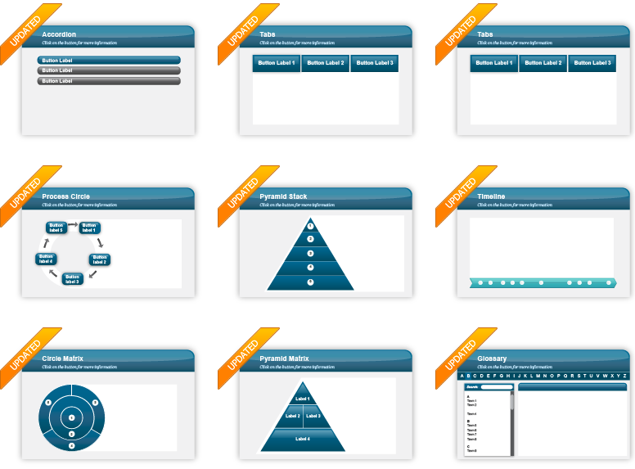
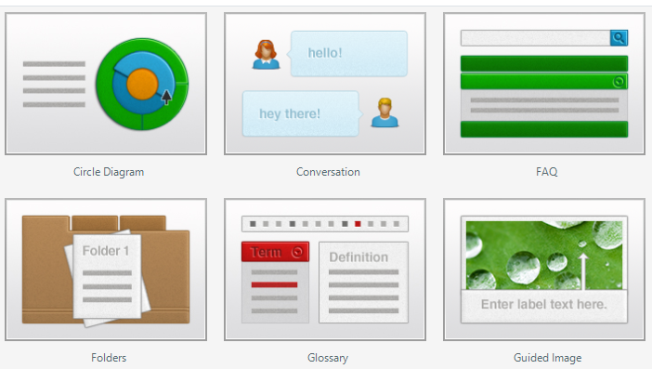
Sample Content Presentation Methods
(Templated Interactions)
Notes:
It’s possible that during the development process we’ll discover that a certain interaction, activity, or delivery method is not working well — either how it fits with everything else, or maybe it’s just too complex.
In that case, we’ll more than likely have an alternative solution or two for you because we’re constantly thinking “how can we make this better?”
These interactions are not set in stone forever — to meet the project deadline, yes; forever, no.
Part of instructional design involves implementing and evaluating. You have to try it out, get feedback from your learners, and then we can update or change these modules in the future.

Slide 10
Sample Checks for Understanding Interactions (Templated)
Notes:
All of this also applies to various Checks for Understanding or “quizzing.”
Your standard quiz questions are still available online — true/false, multiple choice, fill-in-the-blank, matching — and many more.
But, we’ll usually make otherwise plain quiz questions follow the same theme used throughout a presentations or module —
theme elements such as colors, avatars, feedback type, etc.
Also, we can add multimedia elements to questions and answers.
Even if you have multiple types of content presentation methods and checks for understanding interactions for engaging learners, research has shown than “humanizing” content can enhance learning.

Slide 11
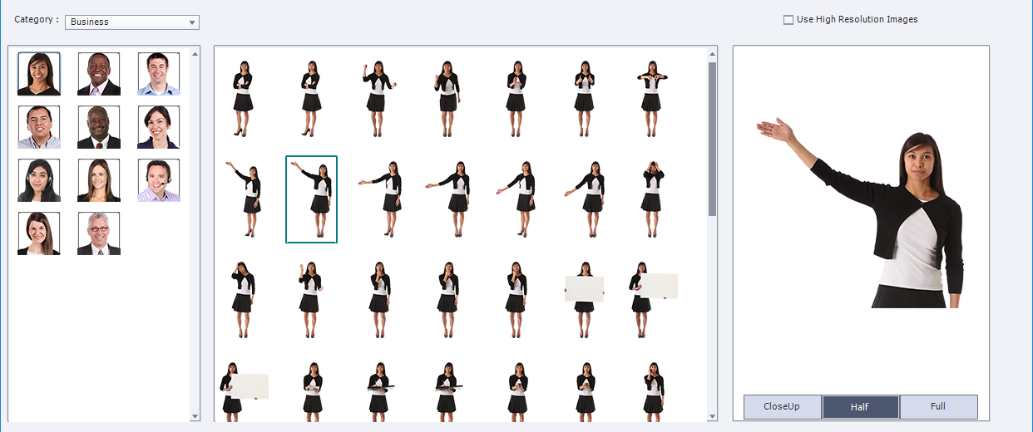
Models and similar built-in assets available
Notes:
Adding a human element, such as a virtual host or narrator, can draw learners into eLearning and help the content seem more relevant or important.
We have a virtual library of models and illustrated avatars that, if used carefully, can help enhance content delivery.
What would be great is if you or someone on your team would serve host and/or narrate your eLearning module:
Videos with you introducing and concluding the module and you narrating the module would enhance it tremendously. It’ll add a personal touch and a sign of importance. People can see your passion for the content, and that passion will trickle down to the learner.
But, we have to gage the application of these elements on a case-by-case basis.

Slide 12
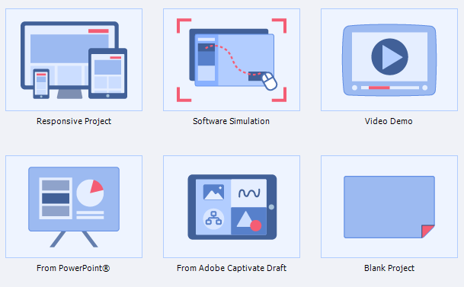
Other Project Types
Notes:
In addition to the different types of content presentation methods and checks for understanding, we can create other types of eLearning-related products, such as:
Responsive websites or training modules that are designed to be viewable on mobile devices — and you’ll see an example shortly
Software Simulations and Video Demonstrations, which are closely related — They’re basically screencasts or videos showing step-by-step use of software or websites. — And you’ll see an example of this shortly, too.
As mentioned earlier, an example of Rapid eLearning can be simply converting your PowerPoint presentation with narrated slides into a format that is viewable in a web browser.
And, of course, we can develop custom projects from scratch.

Slide 13
Delivery Methods
“Standalone”
Direct access
Schoology
DoDEA’s Learning Management System (LMS)
Two Types of Content Delivery:
Courses
Groups
Notes:
With all of the different types of products that we can create, we need some sort of delivery method. — Where is the product going to go?
We can create “standalone” products.
These are items that allow direct access — we provide a web link directly it and it appears in a web browser; anyone can access it.
A typical eLearning delivery method is through our learning management system (or LMS) — Schoology.
Schoology basically has two content delivery methods:
Courses — which mainly are used to track user interaction and allow interactions between teacher and student, student and student, and student and content.
and Groups — which mainly serve as repositories of related content.
NOTE: Due to how Schoology works, some interactive content will not display within a Group.
Schoology has a lot of capabilities for creating and delivering eLearning, so it’s a topic that we can or should cover more in-depth at a later date.

Slide 14
(Previous Work)
Notes:
At this time, we’d like to show you some samples of our previous work. (SELECT LINK TO OPEN WEBSITE)
These samples are housed on the Instructional Design Services website, which you can access from anywhere at any time, 24-7-365.
(Note: Some of the web products that we produce must be viewed in Google Chrome when using a DoDEA computer.)

Slide 15
ID Support Request Form
Notes:
So, how do you get started with getting help from instructional designers?
We’ll start with a simple, one-page form. (SELECT LINK AND SWITCH TO FORM)
This is the beginning of the process….

Slide 16
Conclusion
Content Development Types
Basic, Interactive, Advanced
Sample Interactions
Previous Projects
IDS Website
ID Support Request Form
Google Form
Notes:
During this presentation, participants learned about:
Three content development types, which are:
Basic, Interactive, and Advanced
Sample Interactions, which are based on your content, and can be built with either pre-made templates or a custom design
A few Previous Projects that we have on display on the Instructional Design Services website, which contains much more information about the team and the services that we provide.
And the ID Support Request Form, which you access from the Contact page on our website.

