Slide 1
All Sure Start Educators
Sure Start Annual Training
Early Childhood Environment Rating Scale-Revised
Notes:
Title Slide
All Sure Start staff should receive this training once.
2016-17 (all staff)
Subsequent years 2017→ only new teachers and paras

Slide 2

Learner Outcomes
Participants will:
Understand the Early Childhood Environment Rating Scale-Revised and how to use it as part of the program evaluation.
Notes:
Time 5 minutes
Participants will:
Understand the Early Childhood Environment Rating Scale-Revised and how to use it as part of the program evaluation.

Slide 3

Early Childhood Environment Rating Scale-Revised
ECERS-R
Notes:
Time 0 minutes
Transition slide to Early Childhood Environment Rating Scale

Slide 4

ECERS-R Program Evaluation Tool
Designed to assess process quality in early childhood programs.
Quality programs must provide for the three basic needs all children have:
  Protection of their health and safety
  Building positive relationships
  Opportunities for stimulation and learning from experience
Notes:
Time 5 minutes
DoDEA Sure Start Programs incorporate Program Evaluation in the Education Component-Standard 12-The program will provide for self-evaluation.
This is the reflective tool used for program improvement. The ECERS-R is just one of the tools that used to complete the Sure Start Program Continuous Improvement Plan.
This tool replaces the Abbott-Shim that was previously used.
The ECERS-R
Designed to assess process quality in an early childhood programs
Quality program must provide for the three basic needs all children have:
Protection of their health and safety
Building positive relationships
Opportunities for stimulation and learning from experience

Slide 5

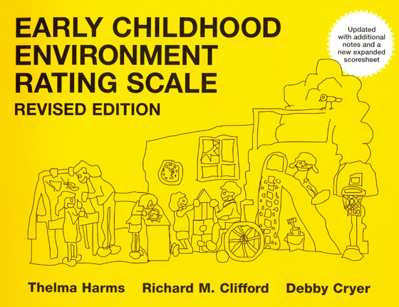

ECERS-R
Part 1 Introduction
Part 2 Introduction
Video Observations
Notes:
Time 3.5-4 hours (depend on participants use of the tool and number of questions and discussion)
Facilitator Handout: ECERS-R DVD NOTES (these are also located in the DVD case)
Load the DVD
Participant Materials: Ensure that participants have the Training workbook and ECERS-R
One training workbook was purchased per school, the teacher and para should work as a team. A collaborative effort with conversations will help facilitate learning and working together.
The ECERS-R is for each Sure Start Program. The Rating Scales in the back is approved for copying for use each time. This eliminates the need to order replacements.
FACILITATOR: Use the DVD notes to facilitate the training.
Play Part 1:
Instruct participants to follow along in their workbook
At the end of part 1, instruct participants to complete the print activities (pages 5-9) in the Training workbook
Answers are in the DVD Instructor’s Guide
Play Part 2:
Instruct participants to read Item-6 Child-related displays (page 10)
Begin Video Observation section
Follow instructions

Slide 6

Questions
Notes:
Time 10 minutes
Review Learner Outcomes
Participants will:
Understand the Early Childhood Environment Rating Scale-Revised and how to use it as part of the program evaluation.
Training evaluation for ECERS-R module should be completed at this time. Evaluation is located on the Pre-K/Sure Start Schoology Site or here:
https://surveys.dodea.edu/n/SSTrainingEval.aspx

